Slide 1
1: Guided introduction
Use the PowerPoint files Intro Material Delays - Mixer.pptx” and “Intro Material Delays - Pipeline.pptx”
To present the lessons, time step by time step. There is one sheet for each time step. For each sheet: when it appears, ask students to observe and describe what happens here. From the second time step on, ask what changes as compared to the previous time step. Direct their attention to the graph in the lower left corner, where the behavior of the variables (so far) is shown. Ask students to check if the graph and their descriptions correspond to each other.
After the last timestep, the following sheet summarizes the scenery seen form above as Stock & Flow Diagram. Ask students to interpret the diagram and describe what it represents in terms of the observed process. Ask students to recount what has happened using the behavior-over-time graph shown in the sheet.
In the last slide, three additional examples are mentioned. Ask students to narrate each example. Then ask students for more examples they can describe.
5’
09:00
5’
09:00
5’
Customers
10
5
1
Time
time
time
time
Customers
10
5
1
Time

Slide 2
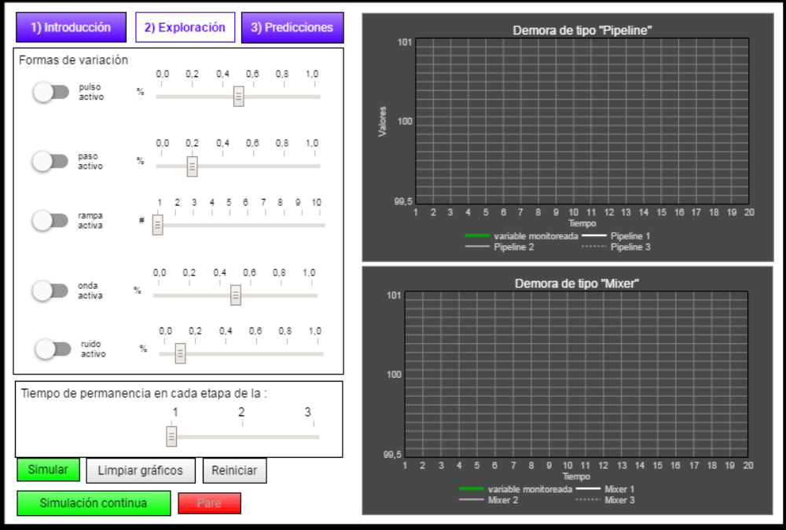
2: Exploration with the simulator
Assure students have the worksheets (“Worksheets Material Delays.pptx”) and acceed the online simulator:
https://exchange.iseesystems.com/public/martin-schaffernicht/material-delays/index.html#page1
Then: in the “Introduction” page, go through the three tutorials (<Explore the concepts>, <Explore the structure of a "pipeline" material delay> and <Explore the structure of a "mixer" material delay>) to explore how the delays’ behaviors react to different changes in the monitored variable’s behavior and get acquainted with the formulation of the model structure:
Explorar
Simular (página “explorar”)
https://exchange.iseesystems.com/public/martin-schaffernicht/demoras-en-sistemas/index.html#page1
Tipo de conducta
 pulsación
 paso
 rampa
 onda
 aleatorio
¿En qué aspecto(s) las demoras “mixer” son similares entre si?
¿En qué aspecto(s) las demoras “pipeline” son similares entre si?
Simulator
Worksheet
¿En qué aspecto(s) las demoras “mixer” son diferente de las demoras “pipeline”?
¿En qué aspecto(s) las demoras “mixer” son diferente según su orden?
¿En qué aspecto(s) las demoras “pipeline” son diferente según su orden?

Slide 3
Explorar
Simular (página “explorar”)
https://exchange.iseesystems.com/public/martin-schaffernicht/demoras-en-sistemas/index.html#page1
1: Select a behavior change for the monitored variable
Tipo de conducta
 pulsación
 paso
 rampa
 onda
 aleatorio
¿En qué aspecto(s) las demoras “mixer” son similares entre si?
¿En qué aspecto(s) las demoras “pipeline” son similares entre si?
2: Adjust the simulation parameters to the selected behavior change of the monitored variable
¿En qué aspecto(s) las demoras “mixer” son diferente de las demoras “pipeline”?
¿En qué aspecto(s) las demoras “mixer” son diferente según su orden?
¿En qué aspecto(s) las demoras “pipeline” son diferente según su orden?
4: Work through the worksheet’s questions.
3: Run the simulation and observe the graphs

Slide 4
3: Predictions with the simulator
In the page “Predictions”, and using the worksheet “Predict – Observe – Compare”:
Select a delay type and a behavior change for the monitored variable in the worksheet and adjust the simulation parameters in the simulator.
Run the simulation and copy the behavior of the monitored variable from graph p. 1 of the simulator to the worksheet.
Sketch the predicted behavior of the delays (1st, 2nd and 3rd order) on the worksheet.
Observe the simulated behavior on p. 2 (Mixer) or p.3 (Pipeline) and copy it to the worksheet.
Compare the predicted and the simulated behaviors and describe what you discover in the worksheet.

Slide 5
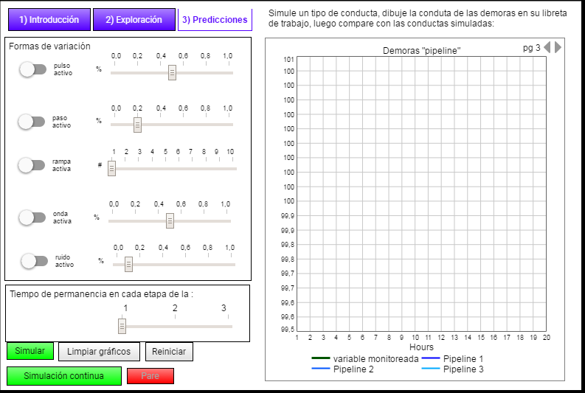
3: Predictions with the simulator
Select a delay type and a behavior change for the monitored variable in the worksheet and adjust the simulation parameters in the simulator.
Predecir – Observar – Comparar
Tipo de demora
 mixer
 pipeline
Tipo de conducta
 pulsación
 paso
 rampa
 onda
 aleatorio
1
Simular (página “predicciones”, gráfico p1 – sólo variable monitoreada)
………..
2
Dibujar la variable monitoreada
3: Sketch the predicted behavior of the delays (1st, 2nd and 3rd order) on the worksheet.
variable monitoreada
3
Dibujar la predicción de las demoras
demora de 1er orden
Valores
demora de 2^{do} orden
demora de 3er orden
4
Cambiar a gráfico p2 o p3 (según tipo de demora)
5
Dibujar las demoras simuladas
demora de 1er orden
demora de 2^{do} orden
………..
demora de 3er orden
1
2
3
4
5
6
7
8
9
10
11
12
13
14
15
16
17
18
19
20
4: Observe the simulated behavior on p. 2 (Mixer) or p.3 (Pipeline) and copy it to the worksheet.
Tiempo
6
Comparar predicción con simulación: si hay diferencias entre la predicción y la simulación, entonces descríbalas.
2: Run the simulation and copy the behavior of the monitored variable from graph p. 1 of the simulator to the worksheet.
5: Compare the predicted and the simulated behaviors and describe what you discover in the worksheet.

Slide 6
4: Quiz
Guide stundets to do the following:
Go to www.socrative.com and log in as student.
Select the room “MARTINSCHAFFERNICHT” to work through the quiz.
For each graph shown,
  select the delay type (mixer or pipeline) and the order of the delay (1st, 2nd and 3rd order) which has generated the shown behavior;
  copy the correct answer and your own result to the “Diagnose” worksheet.
Ask students to summarize their expirience in the quiz: if their preformance in responding the questions has changed over time, ask them to describe in which way and how.

